Slide 1
Refund / Amount Owed
Pub 4012 Tab K
(Federal 1040-Lines 75-79)
Notes:
1

Slide 2
Federal Refund Options
Pub 4012 Tab K
Refund by check
Choose either E-file: Paper Check or Paper Return as Federal Return Type – same for state
Refund via direct deposit (faster and safer)
Choose either E-file: Direct Deposit or Paper Return with Direct Deposit as Federal Return Type – same for state
Specify account type (checking or savings)
Enter routing & bank account #s twice - to verify accuracy
To split between 2 or 3 accounts, use Form 8888
Do not enter amounts for each account until return figures are finalized, so that refund amount is final
Use refund to purchase savings bonds (use Form 8888)
Use refund to apply to next year’s tax liability
Notes:
2

Slide 3
TS – Federal Refund by Check E-File Section \ Federal Return Type
Choose either E-file: Paper Check or Paper Return
from drop-down menu as Federal return type
Notes:
4 options for Federal return type:
Electronic – return is e-filed, refund check is mailed
Direct Deposit – return is e-filed, refund is direct deposited into bank account
Paper Return with Direct Deposit – return is mailed in, refund is direct deposited into bank account
Paper Return – return is mailed in, refund check is mailed
3

Slide 4
TS – Federal Refund Via Direct Deposit E-File Section \ Federal Return Type
Choose either E-file: Direct Deposit or Paper Return
with Direct Deposit from drop-down menu
as Federal return type
Notes:
4

Slide 5
TS – NJ Refund Options E-File Section \ State Return Type
State Return Type has same 4 options as Federal,
but in a different order
Notes:
The State Return Type has the same 4 options as the Federal, but in a different order
5

Slide 6
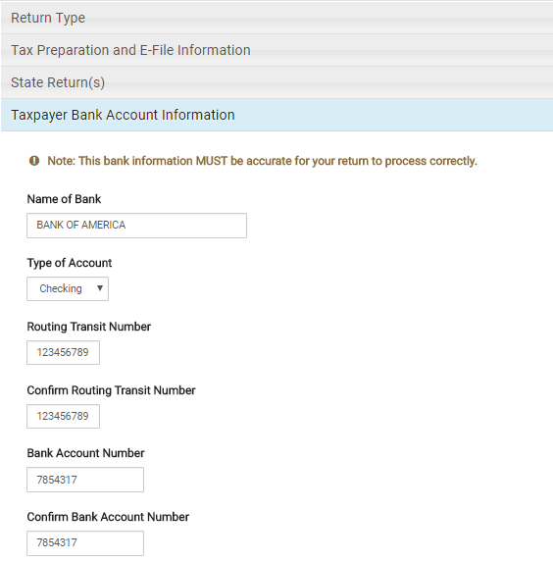
TS – Bank Information for Refund Via Direct Deposit E-File Section \ Taxpayer Bank Account Information
Name of bank
Type of account
Routing # (twice) – 9 digits; must begin with
01 through 12 or 21 through 32
Account # (twice) – include hyphens, but
omit spaces
Notes:
For direct deposit of a refund, counselor must enter name of bank, type of account, bank routing # (twice) & account # (twice)
Routing # is 9 digits; should be taken from actual check, not deposit ticket (which can be different)
Bank account # should be entered exactly as shown on check, not including the check #
Entering an invalid routing number will result in a 4-6 week delay
Direct deposit of a taxpayer’s refund is to be made to an account only in the taxpayer’s name
Financial institutions generally don’t allow a joint refund to be deposited into an individual account
6

Slide 7
Refunds Used To Buy Series I Bonds
Do not need an account to purchase bonds; instructions are on Form 8888
See site manager for help with doing this in TaxSlayer
Can buy for co-owners, e.g. - grandchildren
Can buy up to three in a range of amounts
Flat rate interest + semiannual inflation
Can redeem after 12 months (forfeit 3 months’ interest if redeemed < 5 years)
Taxpayer will receive the bonds (via mail or electronically) and a check for balance of refund
Notes:
7

Slide 8
Refunds Applied to Next Year’s Taxes
Can choose to apply all or part of current year’s refund to next year’s taxes
Enter in Federal Section \ Payments and Estimates \ Apply Overpayment to Next Year's Taxes
TaxSlayer will populate amount to be applied to next year on 1040 Line 77 and re-calculate amount of refund taxpayer will receive this year
Can also choose to apply NJ refund to next year’s taxes
Enter in State section \ Edit \ Enter Myself \ Payments
Notes:
8

Slide 9
TS – Federal Refund Applied to Next Year’s Taxes Federal Section \ Payments and Estimates \ Apply Overpayment to Next Year's Taxes
Amount of refund applied to next year’s taxes
Notes:
9

Slide 10
TS - Refund Applied to Next Year’s Taxes – 1040 Page 2 Line 77
Original refund amount
TaxSlayer reduces refund by amount applied to next year’s taxes
Amount to apply to next year’s taxes
Notes:
10

Slide 11
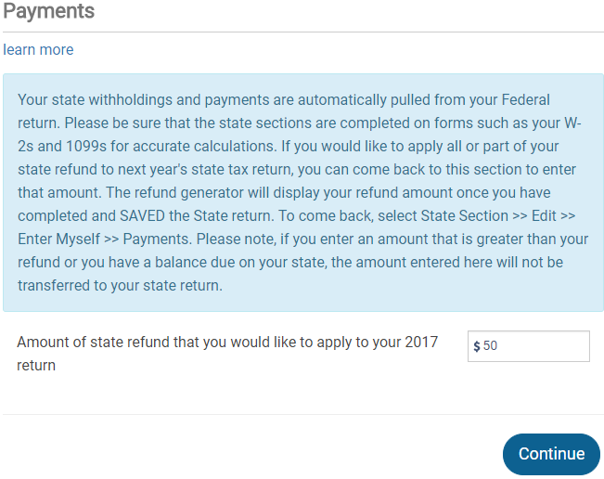
TS – NJ Refund Applied to Next Year’s Taxes State section \ Edit \ Enter Myself \ Payments
Amount of NJ refund applied to next year’s taxes
Notes:
11

Slide 12
Refund Offsets (Garnishments) - Items That Reduce Refunds
Garnishment occurs when a Federal or State agency takes taxpayer’s refund as payment toward a debt
Unpaid Federal taxes
Unpaid state taxes
Earned Income Credit review
Owed child support
Unpaid student loans
Other non-tax debts
Notes:
Taxpayer’s refund amount may be decreased by the IRS due to the items listed here
This occurs once the tax return is filed & may or may not be expected by taxpayer. Counselor would not be aware of these items
12

Slide 13
Amount Owed: Payment Options
Pub 4012 Tab K
Check or money order – send 1040V voucher with payment
Electronic funds transfer (direct debit)
File return immediately & specify date for transfer
Credit card (additional fee)
Installment payments (must arrange with IRS)
Use Form 9465
Interest & penalties apply
Taxpayer can request 60-120 day deferment but interest & penalties still apply
Notes:
13

Slide 14
Tax Penalty for Underpayment of Taxes
TaxSlayer will issue a warning during e-file process if taxpayer may owe penalty (i.e. - owes an amount greater than $1,000 (Federal) /$400 (NJ)
Penalty is Out of Scope, so choose option to file without including penalty (Form 2210)
Alert taxpayer that they may receive a letter from IRS or NJ
Make a note that alert was given to taxpayer in Intake/Interview sheet notes section and in TaxSlayer notes
Notes:
Counselors should discuss the possibility of an IRS penalty with taxpayer
If there is a penalty, the IRS will notify taxpayer with a letter
14

Slide 15
Conditions When Estimated Tax Payments are Required for Next Year
Taxpayer tax liability in current year more than what was withheld and/or paid in advance AND
Taxpayer expects to owe for next year more than $1,000 (Federal)/$400 (NJ) after subtracting tax withheld & tax credits from tax liability AND
Taxpayer expects next year’s tax withheld to be less than:
90% of the tax liability on next year’s return, or
100% of tax liability shown on current year’s return
Estimated taxes required if taxpayer is self-employed
Notes:
15

Slide 16
Federal Estimated Taxes for Next Year – Form 1040-ES
Calculate an estimate of next year’s tax liability
Pay 90% of next year’s estimated tax liability OR
Pay 100% of current year’s tax liability (safe harbor option)
Enter amounts for each required payment in Federal section \ Payments and Estimates \ Vouchers for Next Year's Estimated Payments
4 vouchers will print for submittal
Checks are made payable to US Treasury
Estimated tax payments are due on 4/15, 6/15, 9/15 of next tax year & 1/15 of following tax year (may change due to holidays)
Notes:
16

Slide 17
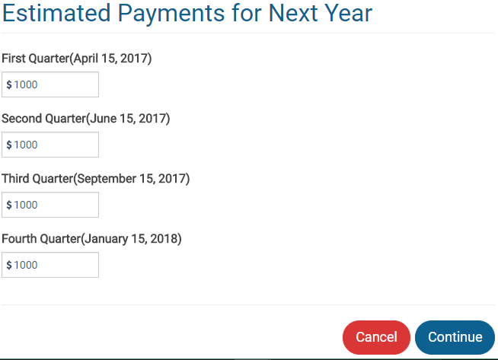
TS - Federal Estimated Taxes for Next Year – Form 1040-ES Federal section \ Payments and Estimates \ Vouchers for Next Year's Estimated Payments
Specify amount to pay
Payment due 4/15
Payment due 6/15
Payment due 9/15
Payment due 1/15
Notes:
17

Slide 18
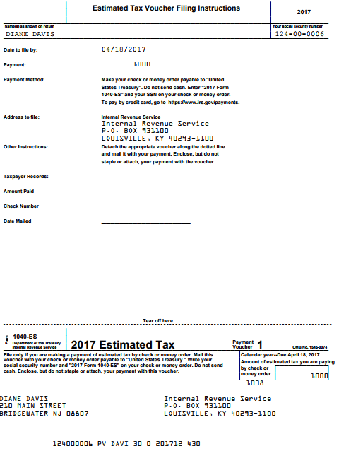
TS – Federal Estimated Taxes Voucher for Next Year – Form 1040-ES
For taxpayer records
Cut off voucher and
submit with payment
Mail in separate envelope from any balance due on current tax year return
Notes:
18

Slide 19
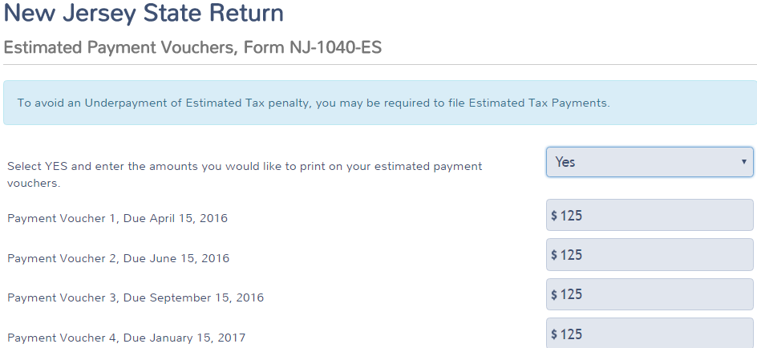
TS – NJ Estimated Taxes for Next Year - Form NJ-1040-ES State Section \ Edit \ Enter Myself \ Miscellaneous Forms \ Estimated Payment Vouchers, Form NJ-1040-ES
Choose Yes from drop-down menu
Payment due 4/15
Payment due 6/15
Payment due 9/15
Payment due 1/15
Notes:
19

Slide 20
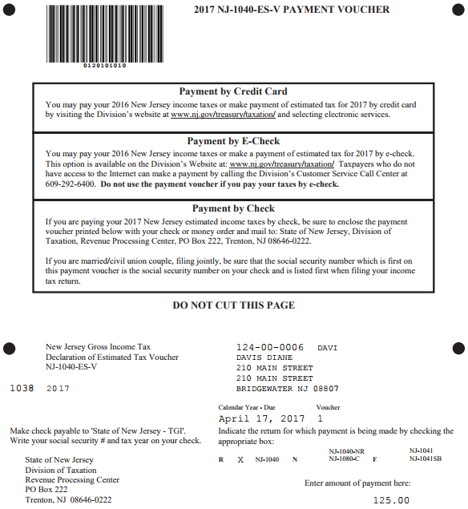
TS – Estimated Payment Vouchers, Form NJ 1040-ES
Mail in the entire page with estimated tax payment;
Mail separately from any balance due on current year tax return
Voucher for first estimated payment

Slide 21
Form W-4 & W-4P - Employee Withholding Allowance
Complete Form W-4 so that employer can withhold the correct Federal income tax from pay
Used if significant current year refund or balance due
Complete Form W-4P for withholdings from pension or annuity
Notes:
21

Slide 22
What If Taxpayer Cannot Pay?
Pay in full within 60 or 120 days with no fee, but interest & penalty will be charged on payments after due date
Apply to make monthly installments using Form 9465 Installment Agreement Request
Fee charged if granted; also interest & penalty
Use credit card to pay
American Express, Discover, MasterCard, Visa
Convenience fee charged by service providers
Notes:
22

